Slide 1
Analyse Azure Cost in PowerBI for Microsoft Sponsorship subscriptions
Peter Perov,
Cloud Solutions Architect

Slide 2
Agenda
Introduction
Cost Management
Demo
QnA

Slide 3


Cost Management

Slide 4
Azure Subscriptions available to CSA
Microsoft managed
fdpo.microsoft.com non-prod tenant
Self managed
https://my.visualstudio.com/ for every FTE - $150 p/m
External tenant
Honourable mention
Microsoft 365 Developer Program – developer E5 licenses * 25, free
Notes:
Visual Studio
Simply login as your Microsoft.com email and choose “Visual Studio Enterprise (FTE)” benefit
Fdpo wiki page:
https://dev.azure.com/servicesdocs/DevOps/_wiki/wikis/AzureInWCB%20wiki/32155/Managed-Azure-Tenant-Environment

Slide 5
Options
Get started with Cost Management + Billing reporting
 | PAYG | MCA | Direct EA, CSP | Indirect EA
Azure Portal - Cost Analysis (*) | Yes | Yes | Yes
EA Portal |  |  |  | Yes
Power BI Connector |  | Yes | Yes
Cost Management API (**) |  | Yes | Yes
Microsoft.Consumption API (**) | Yes | Yes | Yes
(*) Both Cost Management and Cost Management (preview) are available at this time (Nov’22)
(**) multiple APIs available, some in preview, some being deprecated
Notes:
Get started with Cost Management + Billing reporting
https://learn.microsoft.com/en-us/azure/cost-management-billing/costs/reporting-get-started
Azure EA portal administration
https://learn.microsoft.com/en-us/azure/cost-management-billing/manage/ea-portal-administration
Migrate from Azure Enterprise Reporting to Microsoft Cost Management APIs overview
https://learn.microsoft.com/en-us/azure/cost-management-billing/automate/migrate-ea-reporting-arm-apis-overview
EA Portal
https://ea.azure.com
Billing accounts and scopes in the Azure portal
https://learn.microsoft.com/en-us/azure/cost-management-billing/manage/view-all-accounts
View your usage summary details and download reports for direct EA enrollments
https://learn.microsoft.com/en-us/azure/cost-management-billing/manage/direct-ea-azure-usage-charges-invoices

Slide 6
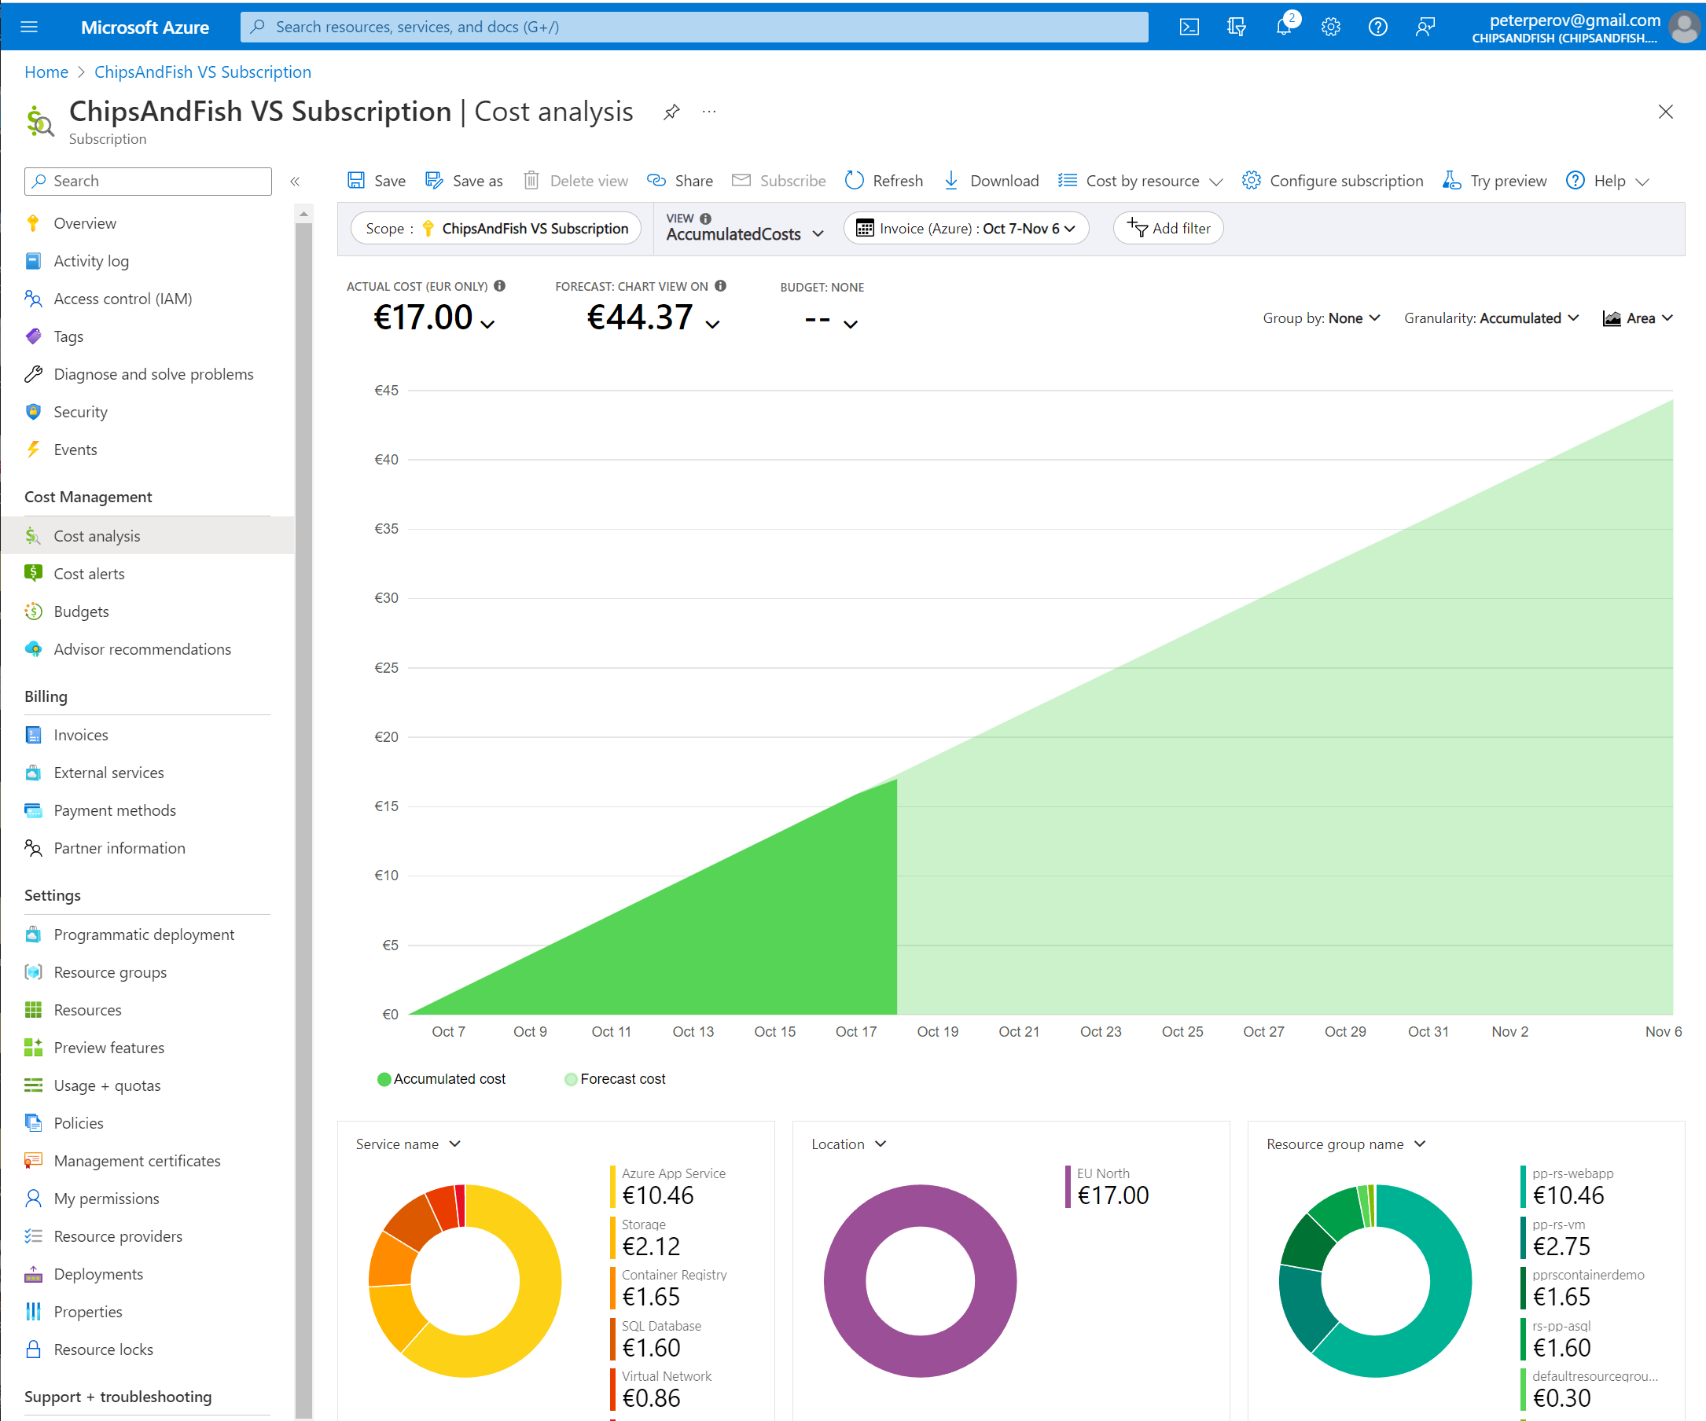
PAYG Customers Azure Portal - Cost Analysis

Slide 7
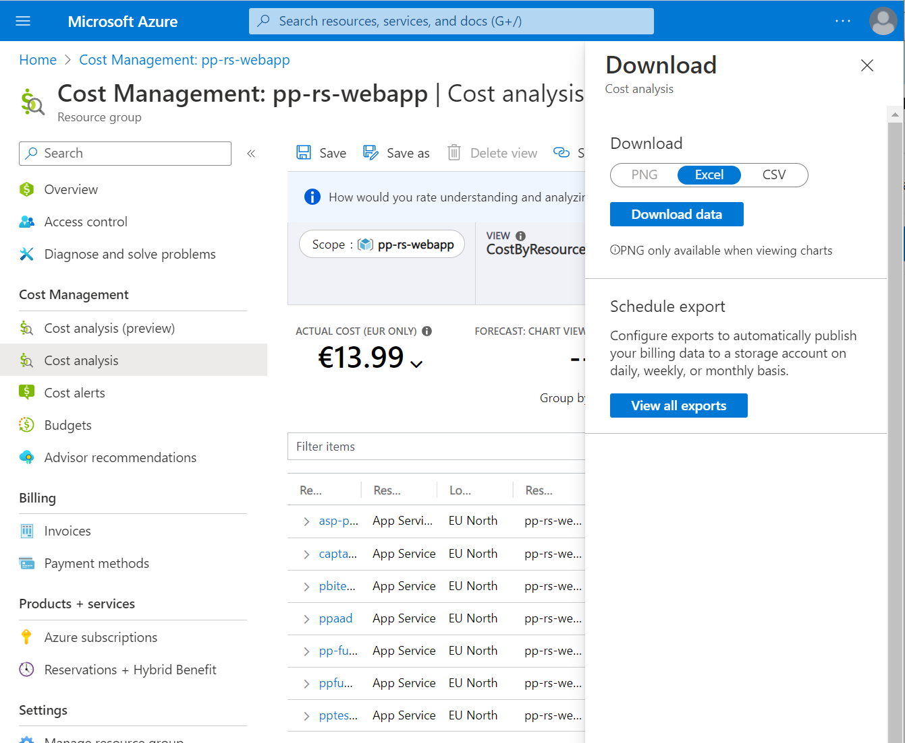
Scheduled Export
Portal -> Cost Analysis
View -> CostByResource
Download
Schedule Export
Configure Storage account
Register RP: Microsoft.CostManagementExports
Subscription
Resource Providers
Register
Create Container
Notes:
Consumption - Usage Details - List
https://docs.microsoft.com/en-us/rest/api/resources/providers/register

Slide 8
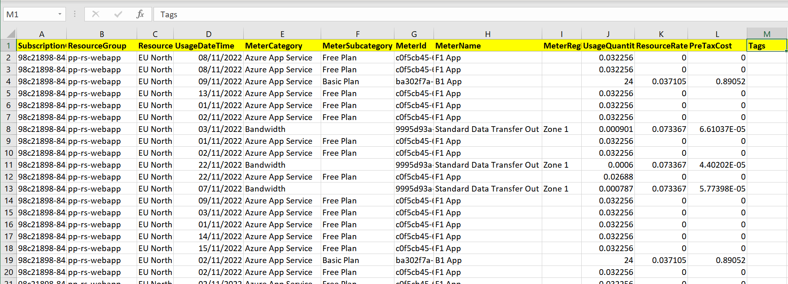
Exported .csv
ResourceGroup
Tags
UsageDateTime
MeterCategory, MeterSubcategory, MeterName
UsageQuantities, ResourceRate, PreTaxCost

Slide 9
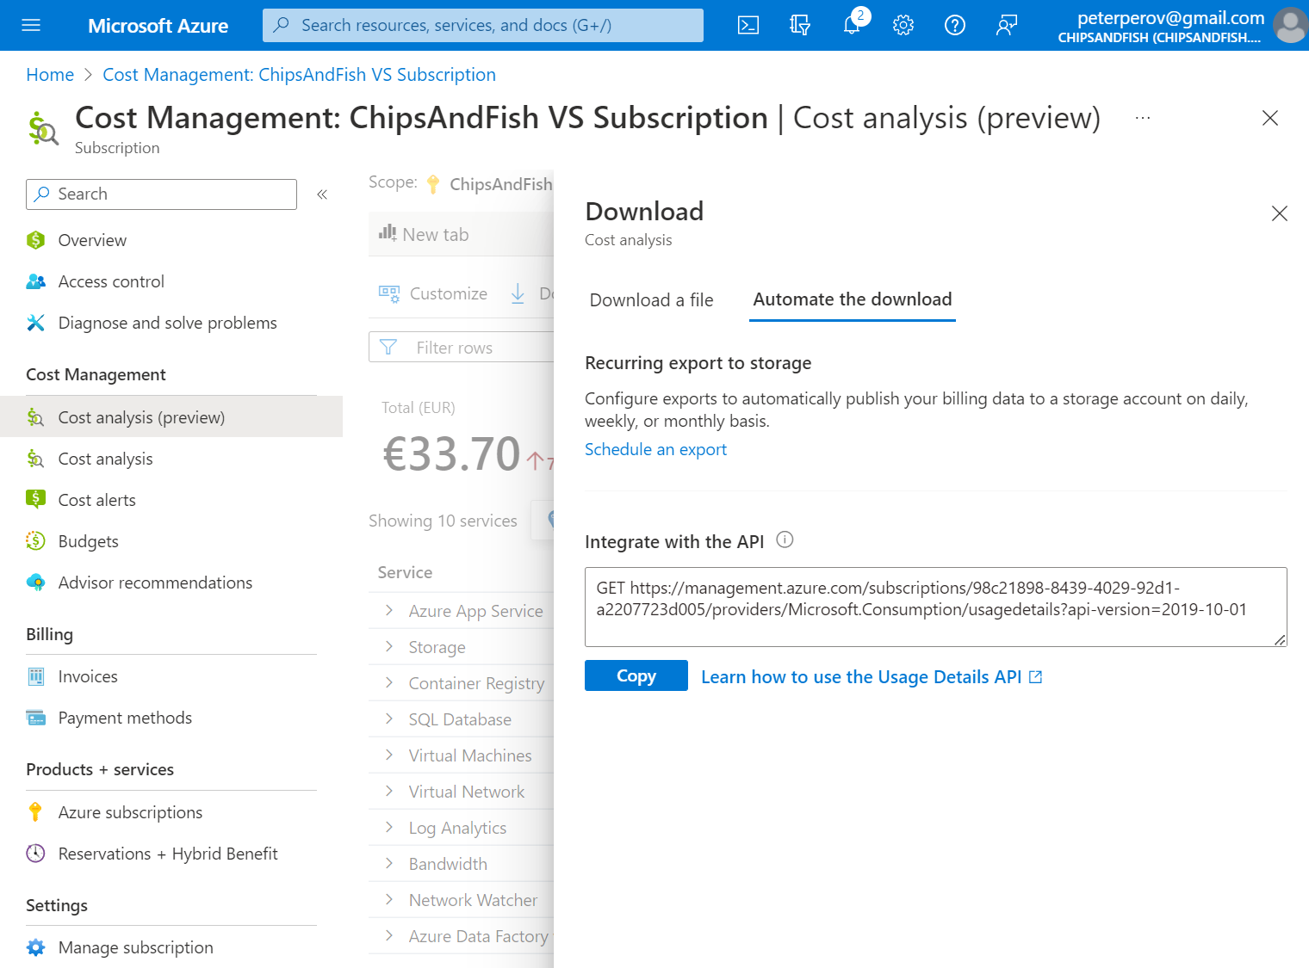
API Export (Preview, Nov’22)
Portal -> Cost Analysis (preview)
Services
Download
Automate the download
Notes:
Full guide on how to call the api: create Service Principal, assign billing scope, use the access token
Getting started with the Microsoft Azure Billing API’s
https://medium.com/@sambowenhughes/getting-started-with-the-microsoft-azure-billing-apis-aa27af11c1d0
Consumption - Usage Details - List
https://learn.microsoft.com/en-us/rest/api/consumption/usage-details/list?tabs=HTTP

Slide 10
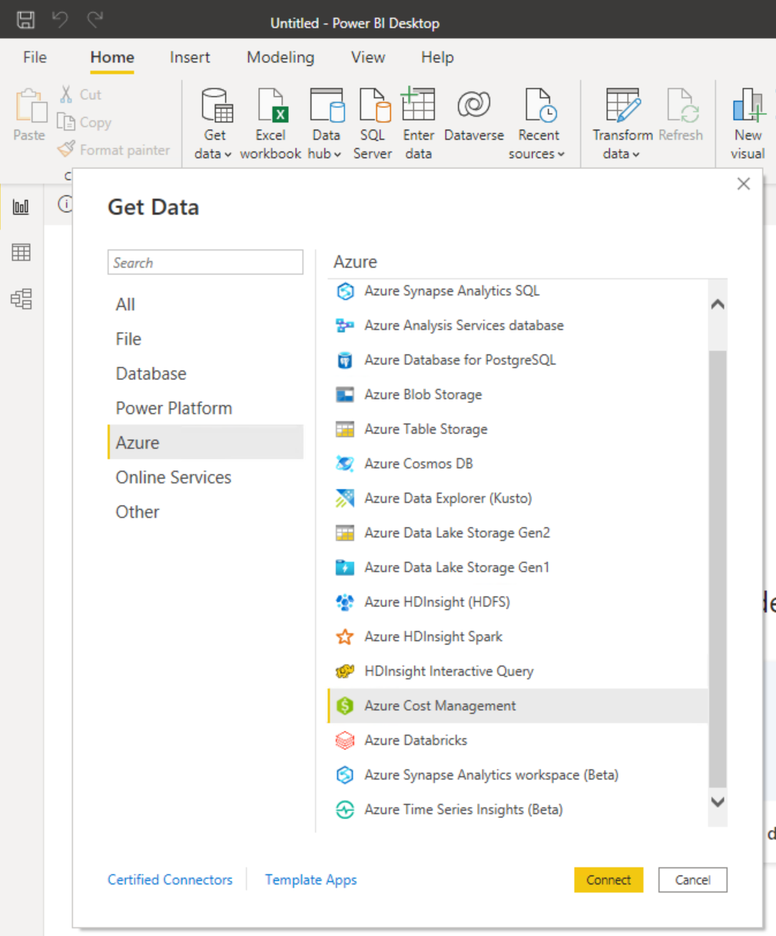
Power BI Cost Management Connector
Direct MCA
EA
Notes:
Create visuals and reports with the Azure Cost Management connector in Power BI Desktop
https://learn.microsoft.com/en-us/power-bi/connect-data/desktop-connect-azure-cost-management

Slide 11
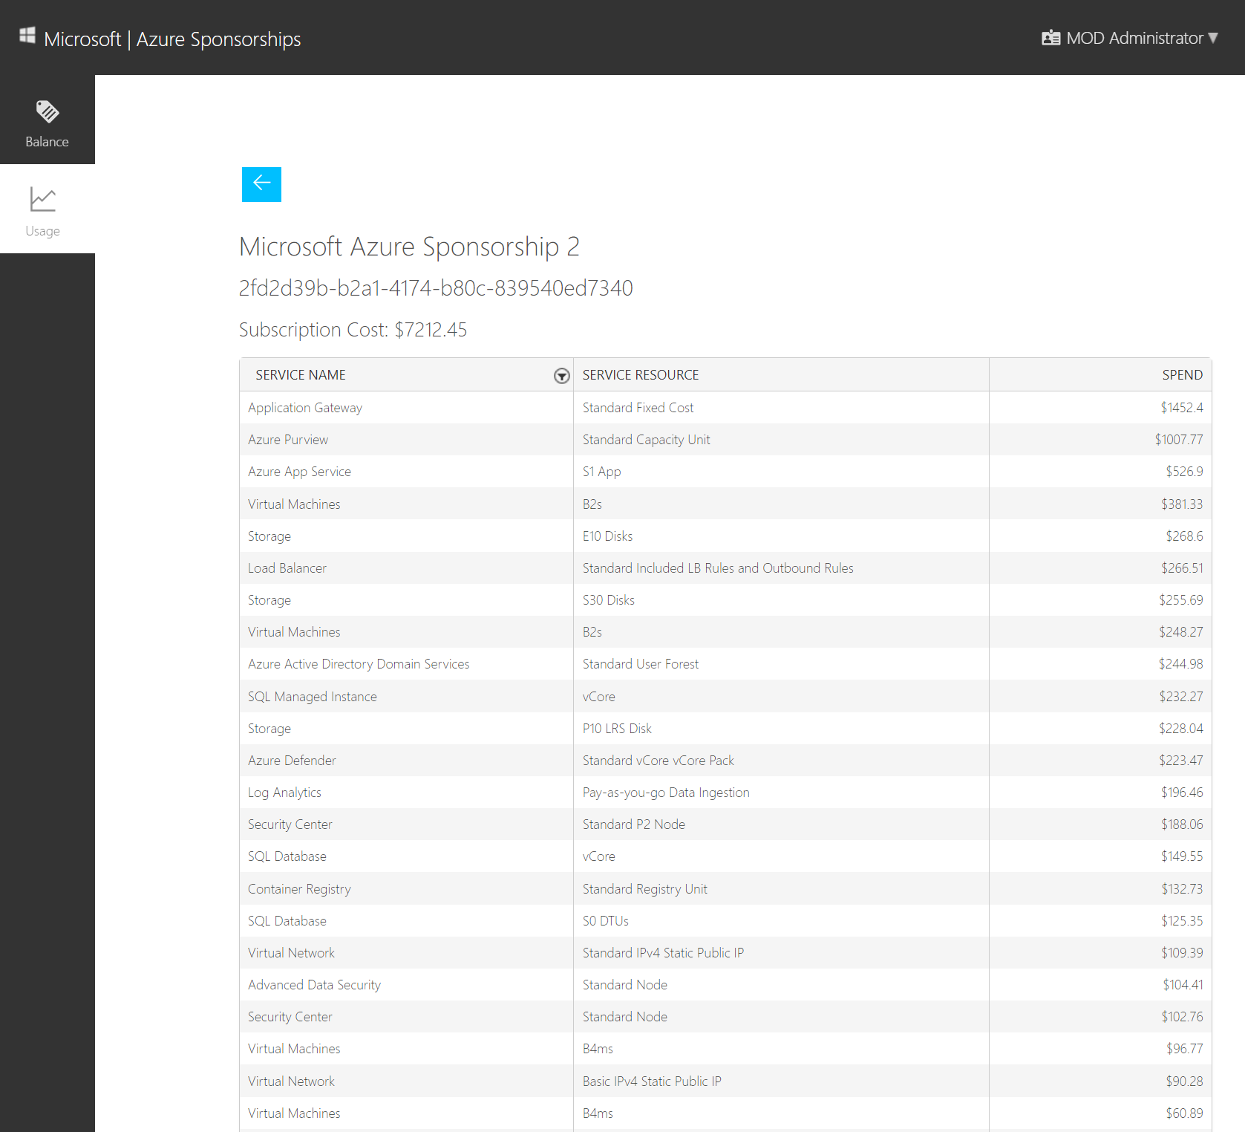
Azure Sponsorship https://microsoftazuresponsorships.com/
Notes:
Important to log in as a subscription owner

Slide 12
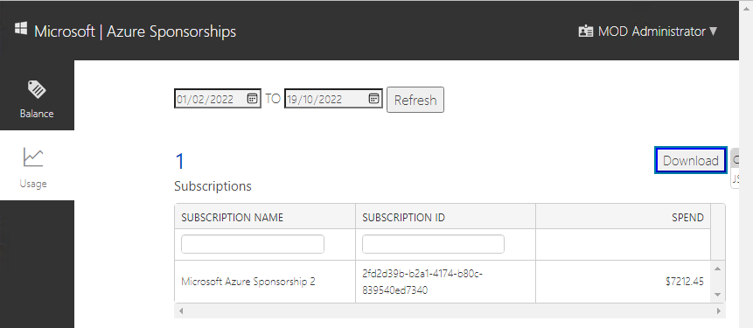
Download .csv
When you click Download, mind the hiding dropdown
Clicking on it will download .csv file with consumption report

Slide 13
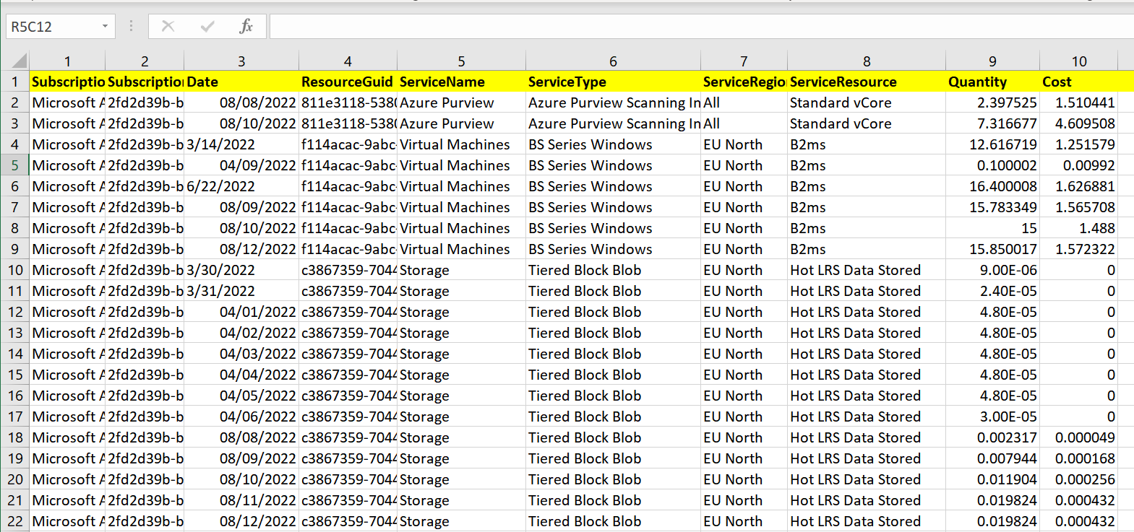
Sponsorship report .csv

Slide 14

Power BI

Slide 15
PowerBI Landscape
PowerBI Desktop - free
PowerBI Service – SaaS application, MW Land
PowerBI Embedded – compute resource on Azure
PowerBI Server – on-prem, usually SQL EE + SA

Slide 16
Demo

Slide 17
Files on GitHub
https://github.com/peterperov/MSFTCSA/tree/main/126-AzureCost

Slide 19
Thank you

Slide 21
What’s missing
.CSV only, no reporting
Dates in US format (mm/DD/yyyy)
Numbers in US format ( #,####.## )

Slide 22
Getting Latest file
Given: list of files AzureUsage (x).csv pick the latest as a source
Solution:
Get Data
Sharepoint Folder
Text filter -> Starts With -> AzureUsage
DateModified -> Date/Time Filter -> Is Latest
Click on “Combine Files” button in the left column header
Rename the Query
Notes:
The best way to connect to a SharePoint Folder to speed up your Excel and Power BI data refresh
https://www.youtube.com/watch?v=-XE7HEZbQiY
Power BI - Use relative references to avoid combine & transform errors
https://www.youtube.com/watch?v=nscUeOL5m90

Slide 23
Date format
Challenge:
Csv file uses MM/DD/YYYY date format whereas most of us using DD/MM/YYYY
Solution:
Split the field by ‘/’ into DD MM and YYYY fields and recombine them to DD/MM/YYYY
PowerQuery
Transform -> Split by ‘/’

Slide 24
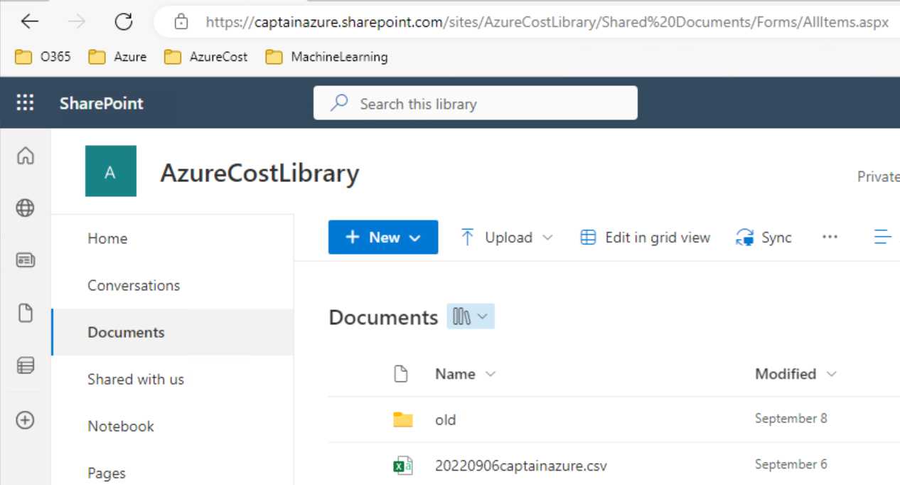
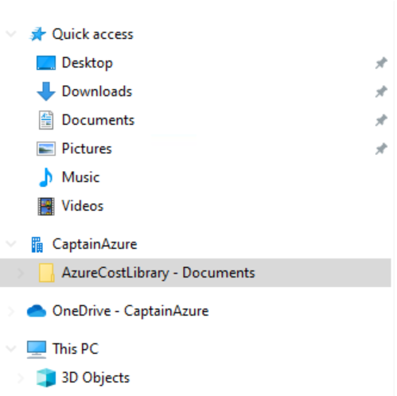
“Sync” will add a shortcut in Explorer

Slide 25
Text layout (without bullet points)
Main topic: Segoe UI, size 28pt
Segoe UI, size 20pt for second level
Segoe UI, size 16pt for third level

Slide 26
Text layout with bulleted text
Main topic: Segoe UI, size 28pt
Segoe UI, size 20pt for second level
Segoe UI, size 16pt for third level

Slide 27
Example with longer headline text wrapping to a second line
When the headline text is 2 lines, move this text block down to align to the lower blue guide
If you don’t see guidelines, click on the View menu, and then check the box in front of “Guides”
Use a “soft return” Shift + Enter to wrap text without adding extra line spacing

Slide 28
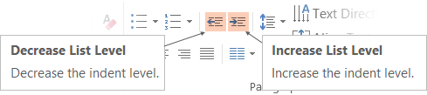
Adjusting list levels
Main topic: Segoe UI, size 28pt
Segoe UI, size 20pt for second level
Segoe UI, size 16pt for third level
Use the “Decrease List Level” and “Increase List Level” tools on the Home menu to change text levels.
Try this:
Place your cursor in the line of text that says “Segoe UI, size 20pt for second level”
Next click the Home tab, and then on the “Decrease List level” tool. Notice how the line moves up one level.
Now try placing your cursor in one of the top “Main topic…” line of text. Click the “Increase List Level” tool and see how the text is pushed in one level.
Use these 2 tools to adjust your text levels as you work

Slide 29
Bullet points layout with subtitle Set the subtitle to 20pt in the same text block, with character spacing Normal
Move the text block down vertically to align to lower guide
If you don’t see guidelines, click on the View menu, and then check the box in front of “Guides”
Hyperlink style: www.microsoft.com

